Slide 1
Scrapy Hands-on
By :
Pushkar Chauhan
Archak G Amruth
Dhiraj Suthar

Slide 2
Scrapy
Web crawling/web scraping framework.
Open source, free to use, Fast and High-level Framework.
Use to crawl websites and extract structured data from their pages.
Use for a wide range of purposes, from data mining to monitoring and automated testing.
Generates feed exports in formats like JSON, CSV, and XML.
Has built-in support for selecting and extracting data from sources either by XPath or CSS expressions.
Scrapy Documentation: https://docs.scrapy.org/en/latest/

Slide 3
Alternatives
Beautiful Soup
Python library for pulling data out of HTML and XML data.
Automatically converts incoming documents to Unicode
Selenium
An open-source tool that automates web browsers.
Provides excellent visibility for testing end-to-end apps.
Open-source and platform-independent.

Slide 4
Pros/Cons Of Scrapy
Pros
Easier to build and scale large crawling projects.
Built-in mechanism called selectors, for extracting the data from websites.
Handles the requests asynchronously and it is fast.
Automatically adjust crawling speed using Auto-Throttling Mechanism.
Ensures developer accessibility.
Cons
Scrapy cannot handle Javascript.

Slide 5
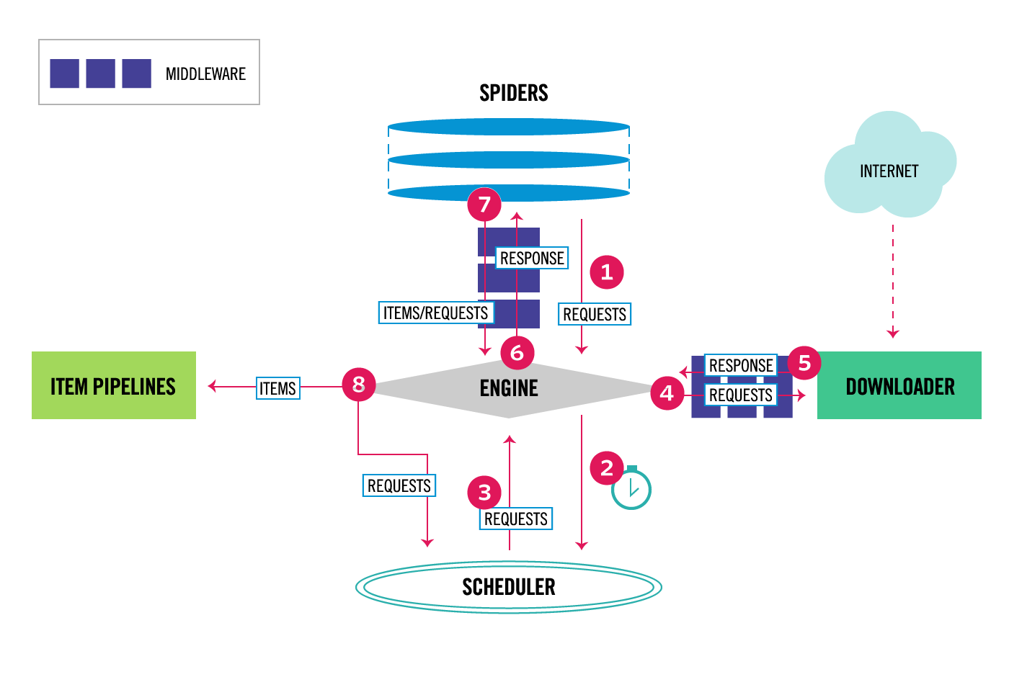
Architecture Overview

Slide 6
Components
Scrapy Engine | is responsible for controlling the data flow between all components of the system, and triggering events.
Scheduler | receives requests from the engine and enqueues them for feeding them later.
Downloader | is responsible for fetching web pages and feeding them to the engine.
Spiders | are custom classes written users to parse responses and extract items from them.
Item Pipeline | is responsible for processing the items once they have been extracted (cleansing, validation and persistence)
Middlewares | Spider middlewares - sit between the Engine and the Spider Downloader middlewares - sit between the Engine and the Downloader

Slide 7
Demo
Installation
Start project
Practice with shell
Write/run a spider(crawler)
Populating the settings
Composing an item-pipeline
Overview on middlewares
Git Repository: https://github.com/Pushkar191098/scrapy-hands-on

Slide 8
Installation
Scrapy requires Python 3.7+
To install Scrapy using PyPI, run:
> pip install Scrapy
To install Scrapy using conda, run:
> conda install -c conda-forge scrapy
Scrapy Installation Guide: https://docs.scrapy.org/en/latest/intro/install.html

Slide 9
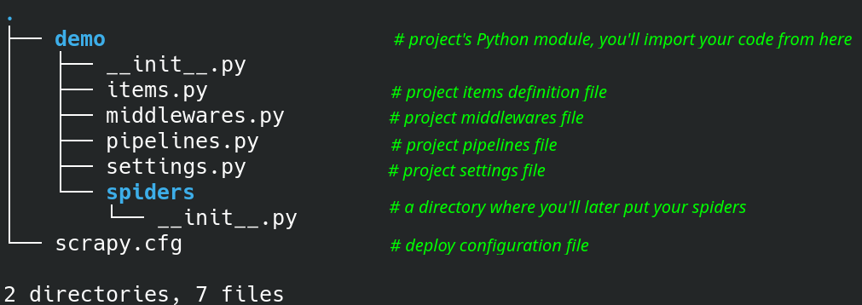
Start Project
To create a project
> scrapy startproject demo
This will create a tutorial directory with the following contents:

Slide 10
Shell
an interactive shell that allows to test your expressions while you’re writing your spider, without having to run the spider to test every change.
is used for testing XPath or CSS expressions and see how they work and what data they extract from the web pages you’re trying to scrape.
Available Shortcuts :
shelp() - prints the help
fetch(url) - fetch response from URL
fetch(request) - fetch response from
request
view(response) - open response in web
browser, for inspection.
Available Objects :
crawler - the current Crawler object.
spider - the Spider which handles the URL
request - a Request object of the last
fetched page
response - a Response object of the last
fetched page.
settings - the current Scrapy settings
Scrapy Shell Guide: https://docs.scrapy.org/en/latest/topics/shell.html

Slide 11
Spiders (Crawlers)
classes that we define and that Scrapy uses to scrape information from a website (or a group of websites).
They must be a subclass of Spider
They must define
initial requests to make
optionally how to follow links in the pages
how to parse the downloaded page content to extract data.
have to be written inside the following directory in your project
> demo/spiders
Scrapy Spiders Guide: https://docs.scrapy.org/en/latest/topics/spiders.html

Slide 12
Running the Spider By File
Run a spider self-contained in a Python file, without having to create a project.
> scrapy runspider kronos.py
List Spiders By Name
List all available spiders in the current project
> scrapy list
Running the Spider By Name
go to the project’s top level directory and run:
> scrapy crawl Kronos

Slide 13
Running the Spider with arguments
Syntax: > scrapy crawl kronos.py -a name1=value1 -a name2=value2
Example: > scrapy crawl kronos.py -a filter=DEPARTMENT
Running the Spider with saving data to file
To append scraped items to the end of FILE
> scrapy crawl kronos.py -o data.json
To dump scraped items into FILE by overwriting
> scrapy crawl kronos.py -O data.json

Slide 14
Settings
allows you to customize the behaviour of all Scrapy components, including the core, extensions, pipelines and spiders themselves.
Ways to populate the settings
Command line options (most precedence)
Settings per-spider
Project settings module
Scrapy Settings Guide: https://docs.scrapy.org/en/latest/topics/settings.html

Slide 15
Item Pipeline
Typical uses of item pipelines are:
cleansing HTML data
validating scraped data (checking that the items contain certain fields)
checking for duplicates (and dropping them)
storing the scraped item in a database
Writing an item pipeline :
Each item pipeline component is a Python class that must implement the following method:
process_item(self, item, spider)
Item (or) Deferred (or) raise DropItem
open_spider(self, spider)
None
close_spider(self, spider)
None
from_crawler(cls, crawler)
Pipeline(new instance)
Item Pipeline Guide: https://docs.scrapy.org/en/latest/topics/item-pipeline.html

Slide 16
Downloader Middleware
is a framework of hooks into Scrapy’s request/response processing.
It’s a light, low-level system for globally altering Scrapy’s requests and responses.
Writing a Downloader Middleware:
Each Downloader Middleware component is a Python class that must implement the following method:
process_request(self, request, spider)
None (or) Response obj (or) Request obj (or) raise IgnoreRequest.
process_response(self, request, response, spider)
Response obj (or) Request obj (or) raise IgnoreRequest.
process_exception(self, request, exception, spider)
None (or) Response obj (or) Request obj
from_crawler(cls, crawler)
middleware(new instance)
Downloader Middleware Guide: https://docs.scrapy.org/en/latest/topics/downloader-middleware.html

Slide 17
Q & A

Slide 18
Performance Optimisation with Scrapy - Case Study
Type Of Website | Avg. Time Taken By Selenium Script | Avg. Time Taken By Scrapy Script | Improvement
Dynamic Website (JSON APIs) | 72s | 29s | 59%
Static Website (JSON APIs) | 45s | 12s | 73%
Static Website (FormData) | 50s | 10s | 80%

Slide 19
Thank You

